Slide 1

Electronics 101
Intro

Slide 2
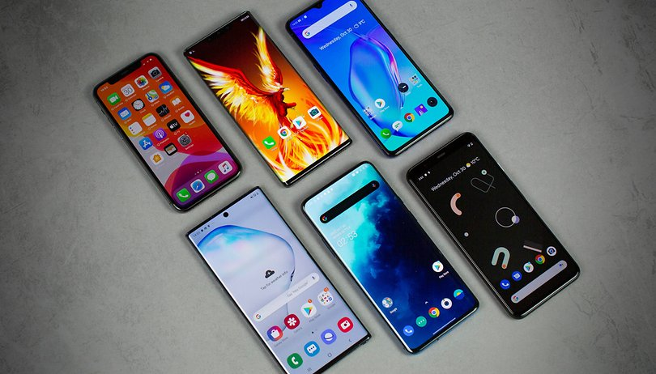
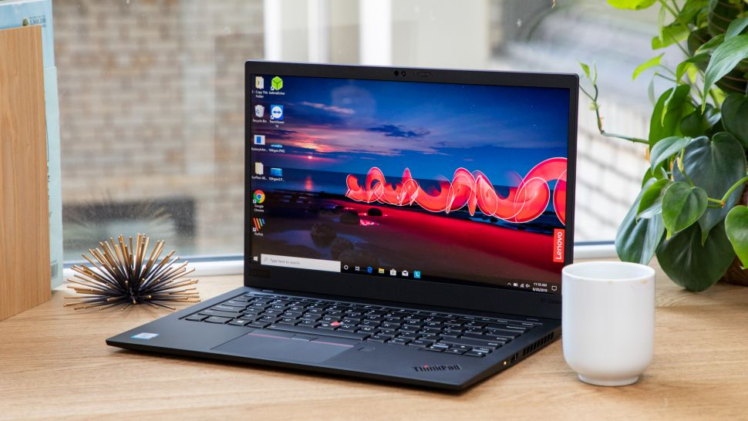
Electronics are Around Us
It’s in our everyday life
Examples of gadgets and devices
Smartphone
Car
Watch
Laptops/desktop computers
Digital Camera

Slide 3
A lot of research is going on
Nanotech
Materials
Internet of Things (IOT)
Quantum Computing

Slide 4
In this series…
I will teach you basic electricity
It’s backstory
Tools to use to measure electricity
Then I will teach you basic components
Resistor
Capacitor
Inductor
Then I will teach you guys circuits

